Slide 1

EDA Project
Hayat Aldhahri

Slide 2
Table of Content
Introduction and Objective
Approach and methodology
Findings
Recommendation

Slide 3




Introduction
Client
New York Orphanage Organization
for the fundraising campaign
Objective
Identify the location or areas with the most traffic to place the fundraisers at those locations
How?
Performing an Exploratory Data Analysis
Source
Freely available data from the MTA website.

Slide 4
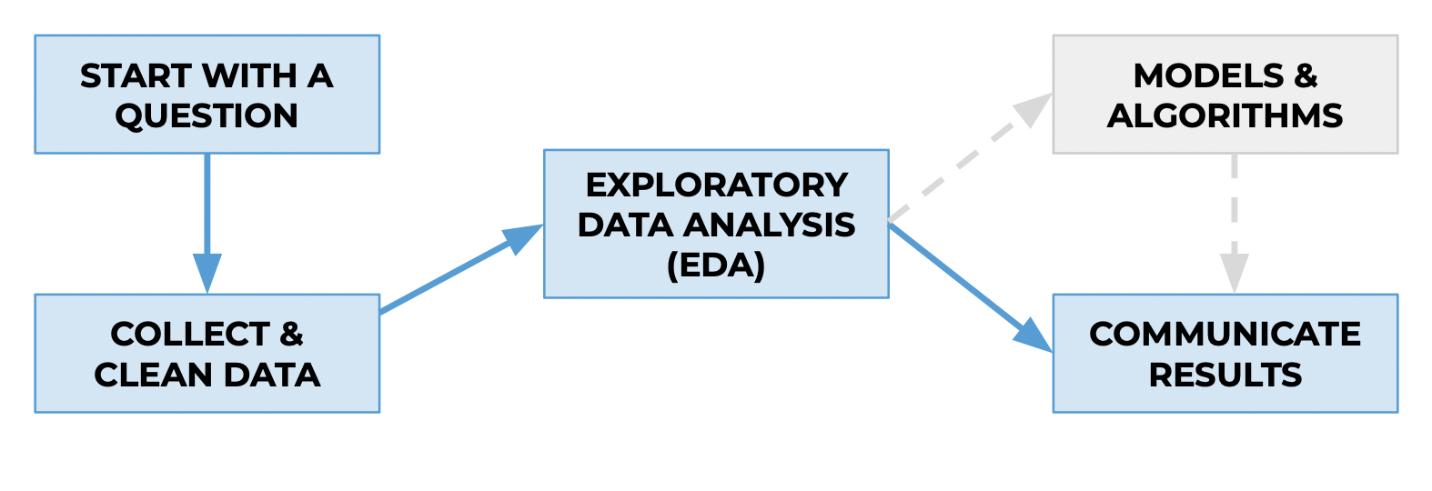
Approach and Methodology
Most Busies Stations?
Busiest by total traffic
3 Months (Sep – Nov 2019)
Weekday vs weekend
Assumptions: maximum number of entries/exits was 3000 for time interval (4-hours)

Slide 5

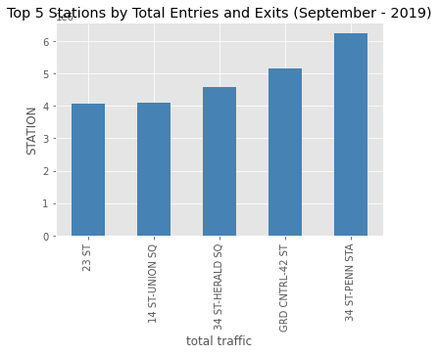
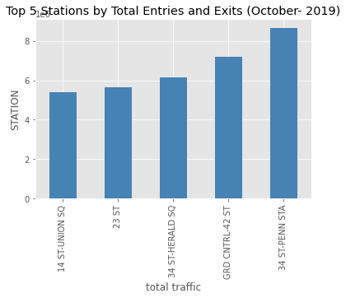
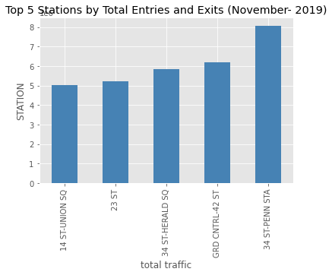
Findings
1. Busiest Stations (top 5)

Slide 6

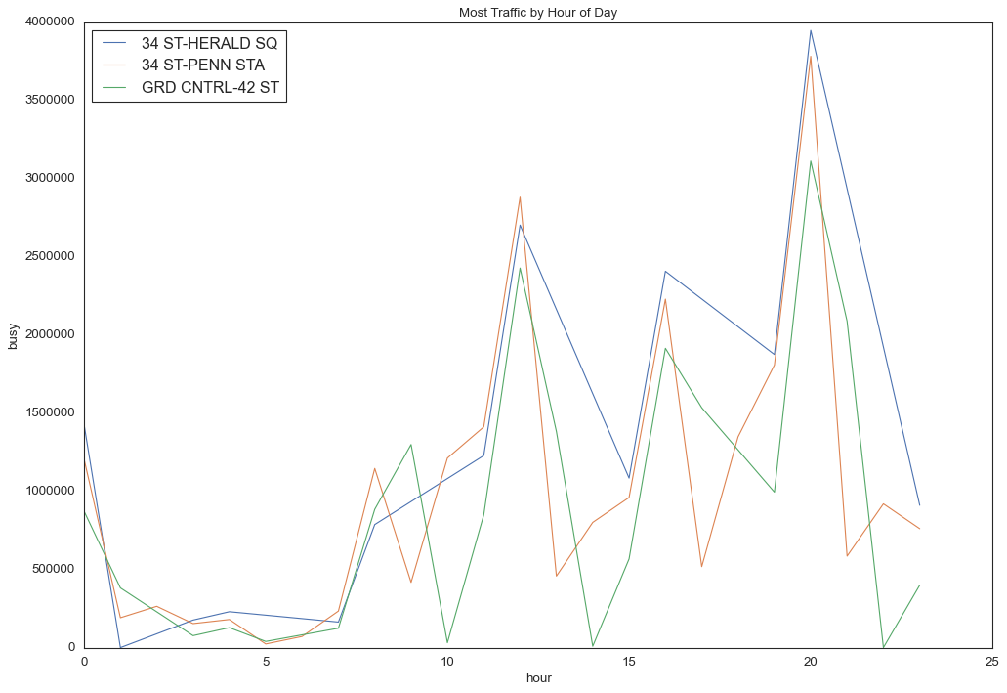
Findings
2. Most Traffic By Hour of Day

Slide 7
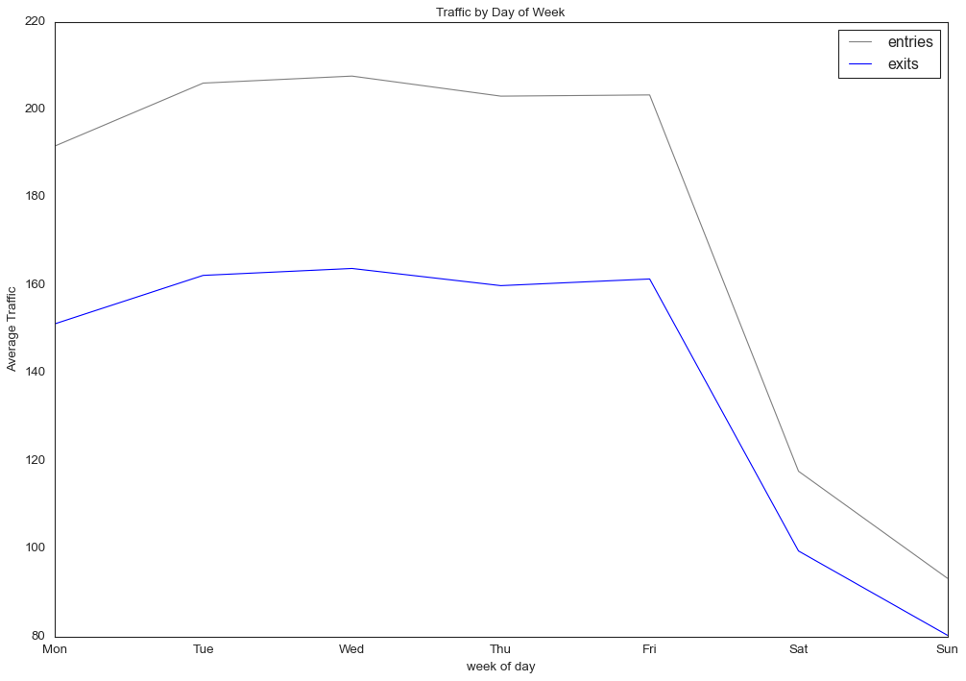

Findings
3. Traffic by the day of week

Slide 8
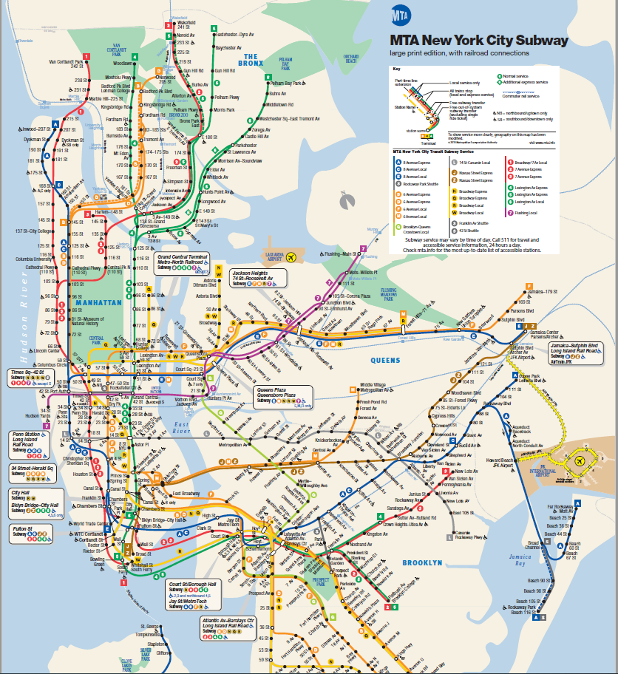

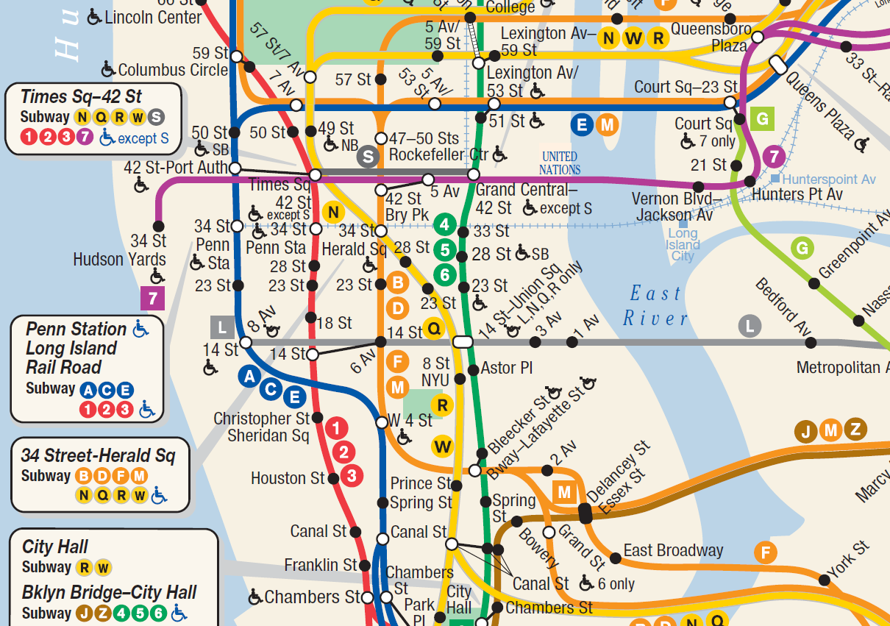
Recommendation
Busiest Stations (top 5)
Date and Time
34 ST-PENN STA
GRD CNTRL-42 ST
34 ST-HERALD SQ
23 ST
14 ST-UNION SQ
Target November
Weekday (preferred)
Hour (10 am to 9 pm)

Slide 9
Thank you

